Slide 1
Lab 4: Memory Mapped I/O
CS341

Slide 2
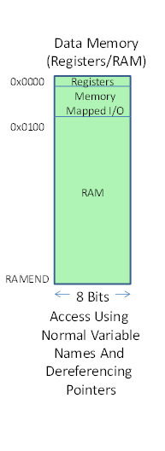
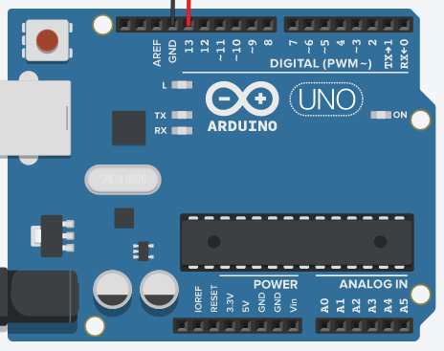
How does Arduino communicate with I/O ports?
Memory Mapped I/O vs Port Mapped I/O
Memory Mapped: I/O space in on same chip as RAM
Port Mapped: I/O space in separate chip
Similar Comparison between Harvard vs Von Neumann
Port mapped is faster as data and address bus do not have to be shared.
However because it is not shared, handling I/O is more tedious
Similar to us looking at EEPROM while talking to RAM
Memory Mapped allows us to manipulate I/O easier.
Simpler to design than port mapped
However, takes up room we could use for more data.
Arduino uses memory mapped. Keeps small amount of space in RAM for each pin
Pins

Slide 3
Today’s Lab: Lab 1 without Arduino provided digitalWrite()
Look closer into how memory mapped I/O works
Determine which bits in RAM/Memory control pin 13
Use provided displayRAM function
Toggle a bit
Blink an LED, again.
To review, take array4 in RAM HEAP from lab3:
Address: 358 359 35A 35B 35C 35D 35E
350: . 3 `. . . . . .A r r a y 4 .
350: 33 30 60 03 00 00 08 00 41 72 72 61 79 20 34 00
Bit 7
0 | 0 | 0 | 0 | 0 | 0 | 0
1 | 1 | 1 | 1 | 1 | 1 | 0
0 | 1 | 1 | 1 | 1 | 0 | 1
0 | 1 | 1 | 0 | 1 | 0 | 1
0 | 0 | 0 | 0 | 1 | 0 | 0
0 | 0 | 0 | 0 | 0 | 0 | 1
0 | 1 | 1 | 0 | 0 | 0 | 0
1 | 0 | 0 | 1 | 1 | 0 | 0
Bit 6
Bit 5
Bit 4
Bit 3
Bit 2
Bit 1
Bit 0

Slide 4
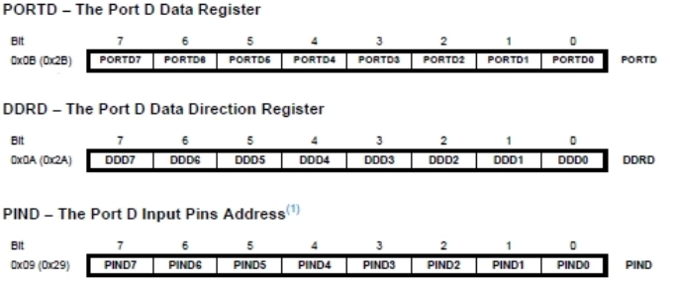
Organization of Pins
Multiple pins are stored in the same port
A port is where we receive input or send output
Controls where to send or not to send current
Port D has 3 corresponding registers that control pins 0-7
The bits that correspond to a given pin are organized by purpose, not by pin
Each pin has 3 bits used to control it.
Data register
Where we write to
0 no current 1 current running to pin
Data Direction Register
Control direction of data
0 input, 1 output
Input Pins
Where we read from
0 no input 1 input received
Digital Pin 3’s Bits

Slide 5
Memory mapped I/O space above the registers before Ram
We don’t address the port registers themselves, instead we use spots reserved for accessing these port registers in ram
The RAM memory addresses used for digital pins 2 through 13 are located between locations 0x20 and 0x2f. Only the cpu can manipulate the actual I/O registers directly.
The first step of today’s lab is finding the memory address that corresponds to the port that holds pin 13 bits

Slide 6
Interfacing with a digital pin
USING PROVIDED FUNCTIONS
DIRECTLY USING MEMORY ADDRESSES
pinMode(int pin, OUTPUT);
pinMode(int pin, INPUT);
digitalWrite(int pin, HIGH);
digitalWrite(int pin, LOW);
digitalRead(int pin);
Set data direction bit to 1
Set data direction bit to 0
Set data bit to 1
Set data bit to 0
Check value of input bit
-By using displayRam, we can use this to locate the specific bits of pin

Slide 7


Blinking LED manually
Let’s say that the address for writing to pin 7 is 0x50 and the correct bit is the 6th bit
0100 0000₂
Then, this code sets pin 7 to HIGH
And this code turns pin 7 on and off for 1 second each
*Note last line is equivalent *pin7 = 0x80
A number xor’d with itself is always 0
0 xor’d with a number is always that number:
1000000^1000000 = 0000000
1000000^0000000= 1000000

